Slide 1

Basic Details of the Team and Problem Statement
Ministry/Organization Name/Student Innovation: AICTE, MIC- Student Innovation
PS Code: SIH1486
Problem Statement Title: Student innovation
Team Name: Travel Bug
Team Leader Name: Sonam Sinha
Institute Code (AISHE):C-56057
Institute Name: Sitamarhi Institute Of Technology
Theme Name: Travel & Tourism

Slide 2
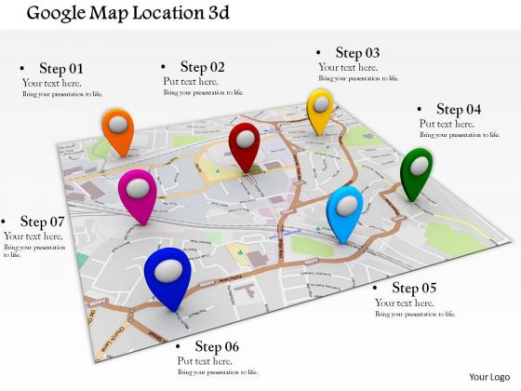





Idea/Approach Details
start
Travel From City A
Describe your idea/Solution/Prototype here:
The aim of the project is to boost the current situation of the Tourism Industries.
Wallet-friendly travelling.
We provide some popular agencies or knowledgeable and friendly Tour Operator.
Be offer optimum place with appropriate location and realistic picture of hotel ,restaurant .
Embarking and Enduring on a journey with health concern.
To create a unique travel experience.
Time Required
price
Daytime Flight
price
Night Flight
Train
Coach
Arrive City B
Describe your Technology stack here:
GPS Tech.
Stack - Frontend technology, Backend technology, Database Technology
Mapping and Visualization

Slide 3
Idea/Approach Details
Describe your Use Cases here
Describe your Dependencies / Show stopper here
Tools used: Google Map API.
Hardware: Android smartphone
Language:- JAVASCRIPT , CSS , HTML
Visual Studio Code
The google map with a marker is displayed on the screen Along with the map
Hardware :-Android smartphone
Communication Network Data Management
Central Server Database and geocoding services
Security
User Interaction

Slide 4
Team Member Details
Team Leader Name: Sonam Sinha
Branch (Btech/Mtech/PhD etc): B.tech Stream (ECE, CSE etc): EE Year (I,II,III,IV): 2nd Year
Team Member 1 Name: Sanjana Kumari
Branch (Btech/Mtech/PhD etc): B.tech Stream (ECE, CSE etc):EE Year (I,II,III,IV): 2nd Year
Team Member 2 Name: Amrita Sinha
Branch (Btech/Mtech/PhD etc): B.tech Stream (ECE, CSE etc):EE Year (I,II,III,IV): 2nd Year
Team Member 3 Name: Supriya Sharma
Branch (Btech/Mtech/PhD etc): B.tech Stream (ECE, CSE etc):EE Year (I,II,III,IV): 2nd Year
Team Member 4 Name: Shobhit Kumar
Branch (Btech/Mtech/PhD etc): B.tech Stream (ECE, CSE etc):EE Year (I,II,III,IV): 2nd Year
Team Member 5 Name: Abhishek Kumar
Branch (Btech/Mtech/PhD etc): B.tech Stream (ECE, CSE etc):CSE Year (I,II,III,IV): 2nd Year
Team Mentor 1 Name: Type Your Name Here
Category (Academic/Industry): Expertise (AI/ML/Blockchain etc): Domain Experience (in years):
Team Mentor 2 Name: Type Your Name Here
Category (Academic/Industry): Expertise (AI/ML/Blockchain etc): Domain Experience (in years):

